Slide 1
Final Project
SAL 603 Mike Mangano

Slide 2
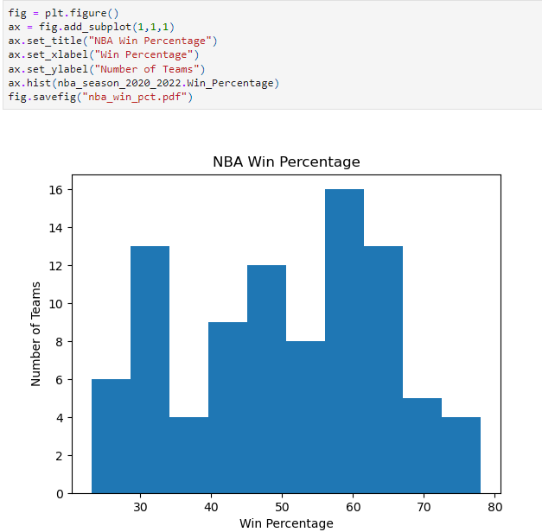
NBA Win % 2020-2022 Seasons

Slide 3
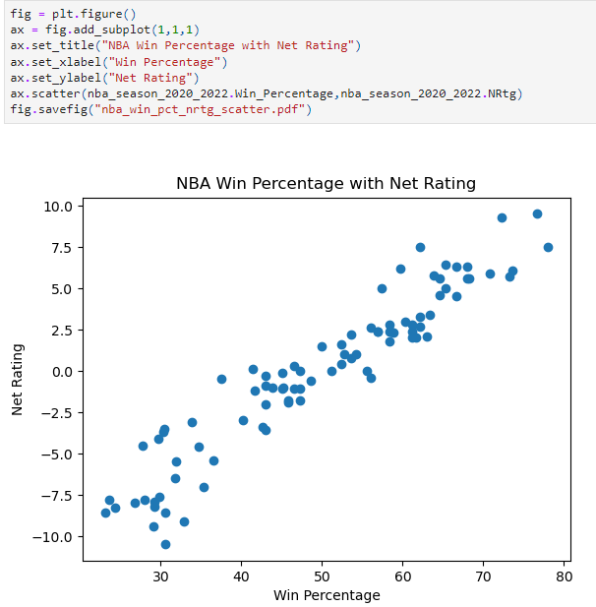
Win % vs. Net Rating

Slide 4
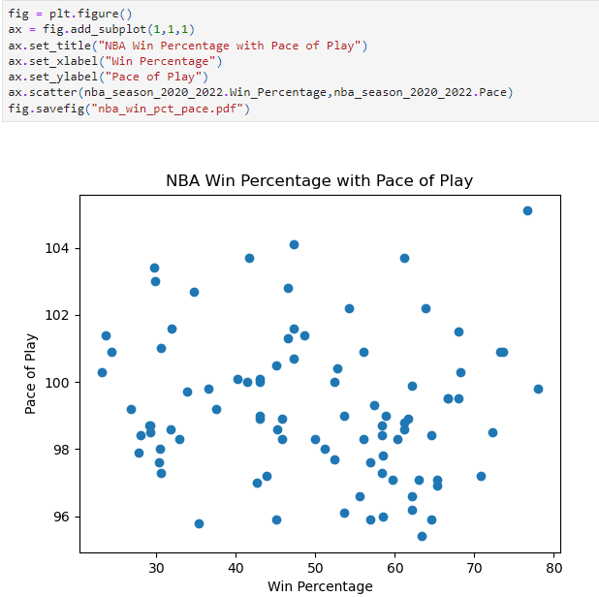
Win & vs. Pace of Play

Slide 5
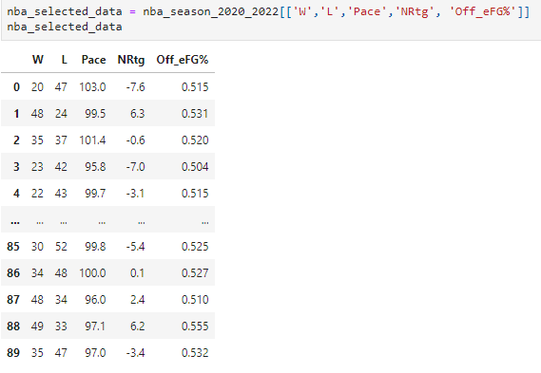
Scatter Plot Matrix Selected Data

Slide 6
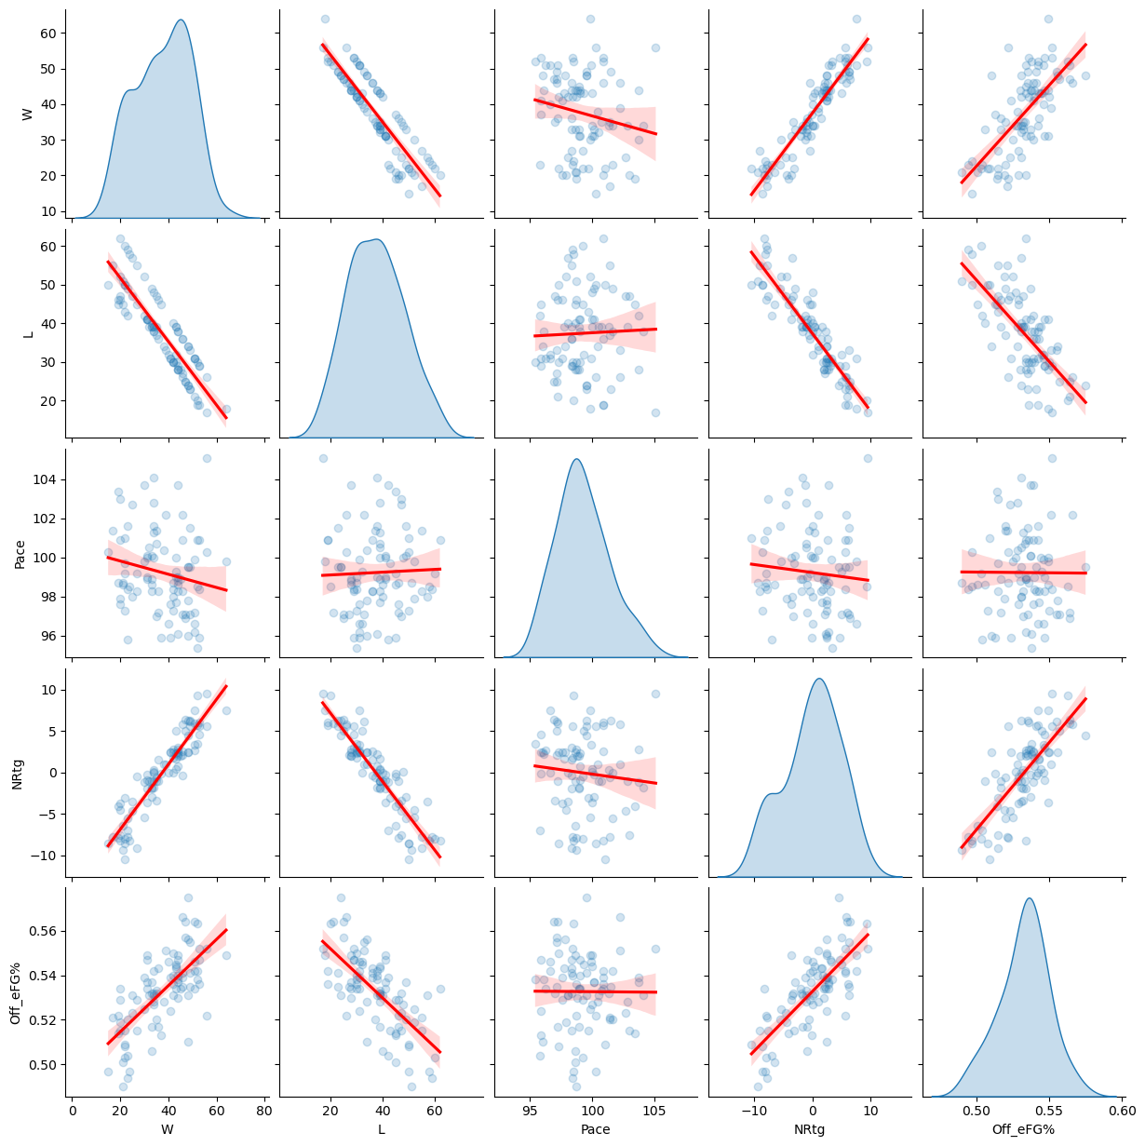
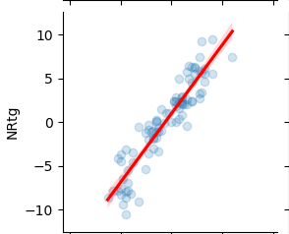
Scatter Plot Matrix
Net Rating had best correlation to games Won

Slide 7
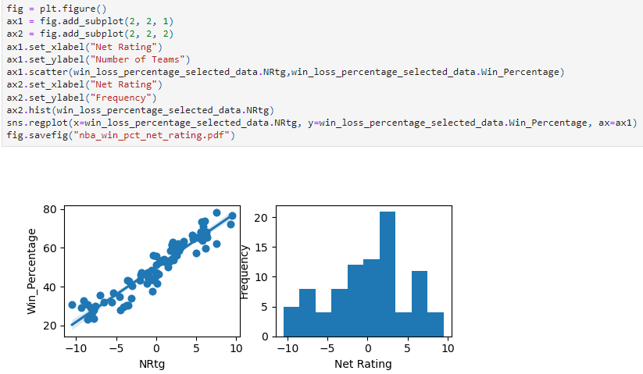
Frequency of Teams with Net Rating & Win %

Slide 8
